Slide 2
Notes:
Delete the period

Slide 3
The Flagship University of the State of New York
Member of the Association of American Universities (AAU)
Largest/Highest Rated Public University in the Northeast
Law, Med., Dent., Bus., Eng. all Ranked Top 100
Over 220,000 Alumni Worldwide
$1.7 Billion Economic Impact
Regional Population (WNY) Over 2.5 Million
UB 2020: Commitment to “Enduring Prominence”
Notes:
Law, Med., Dental, Business, Eng. All Ranked Top 100

Slide 4
Within 500 miles of 11 of top 50 television markets
1. New York (374 miles)
4. Philadelphia (381 miles)
7. Boston (455 miles)
9. Washington D.C. (386 miles)
17. Cleveland-Akron (190 miles)
23. Pittsburgh (216 miles)
25. Indianapolis (500 miles)
26. Baltimore (368 miles)
32. Columbus (326 miles)
34. Cincinnati (433 miles)
41. Harrisburg-Lancaster-Lebanon (285 miles)
51. Buffalo
Notes:
11 of top 50 markets are within 500 miles of UB

Slide 7
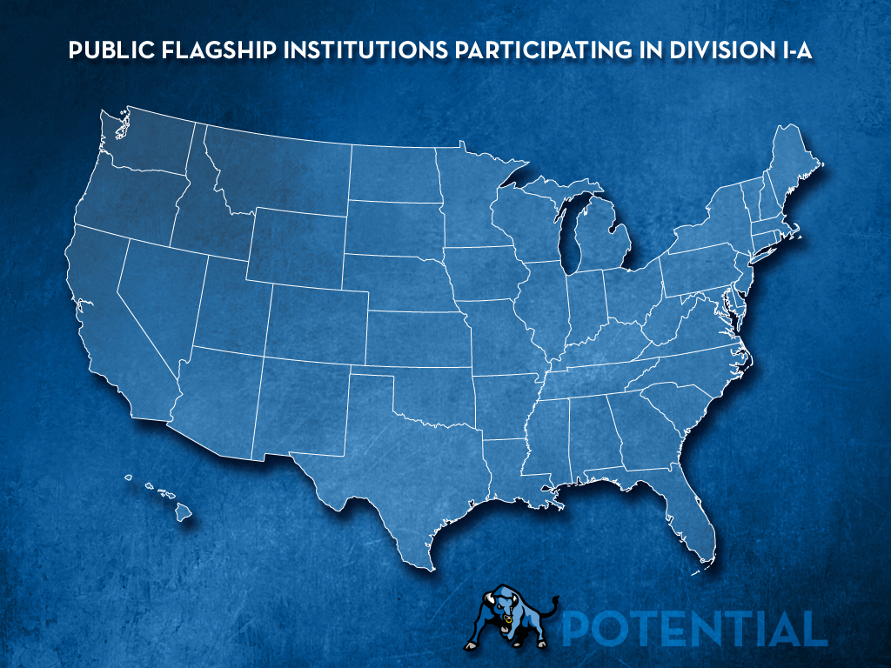

Slide 8
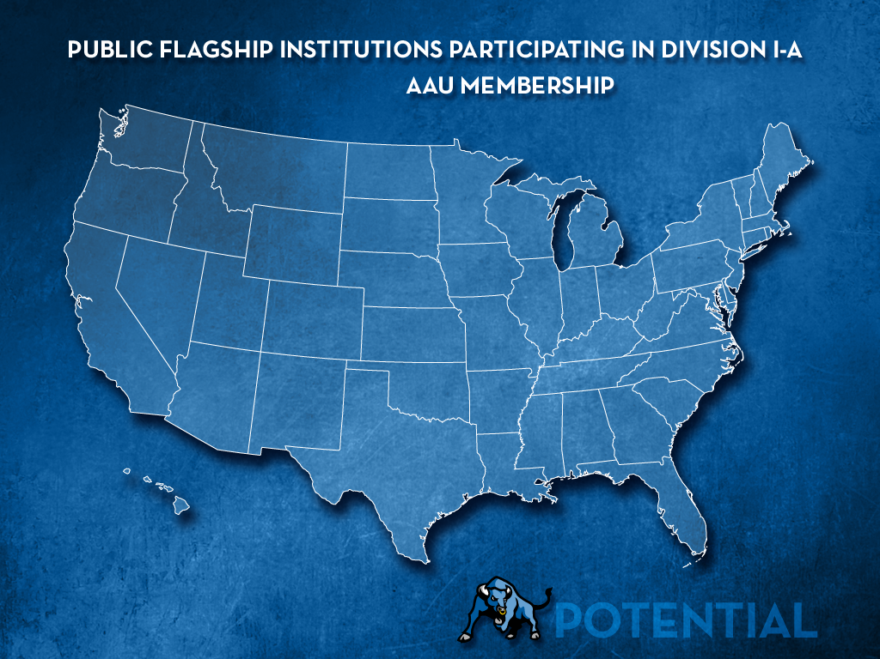

Slide 9
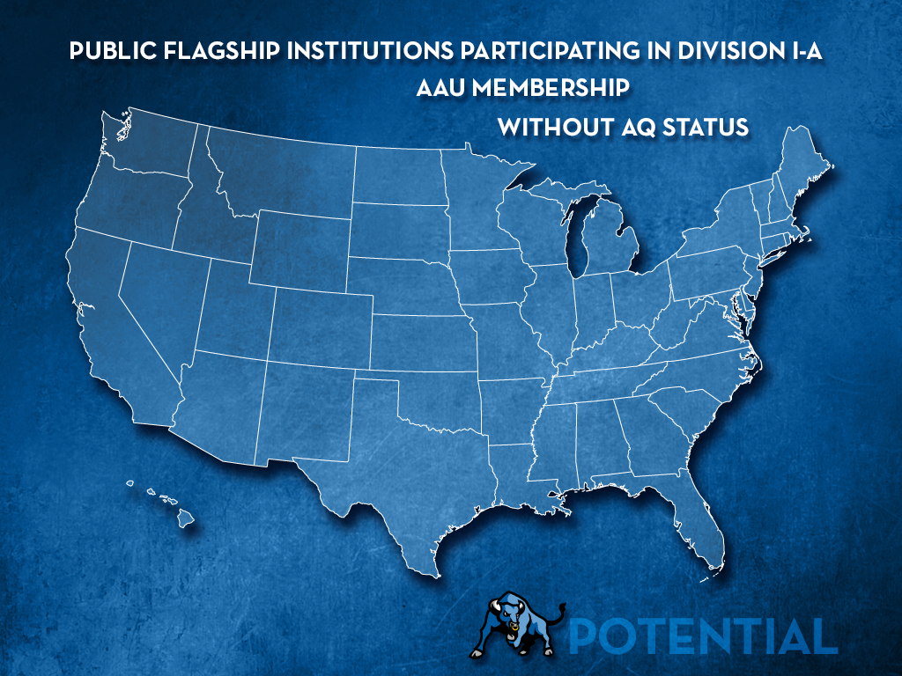

Slide 15
• Department Strategic Plan [6-12 months]
• Facilities Master Plan [12-24 months]
• Creating a “College Athletics” Tradition

